Slide 1


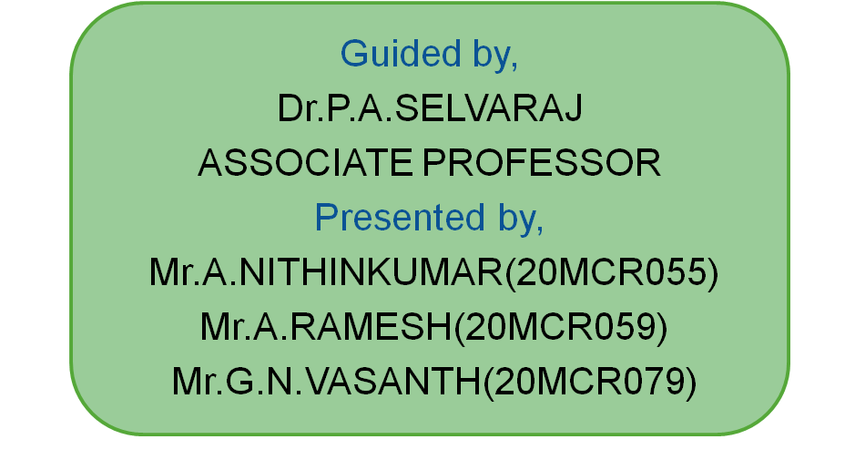

ONLINE TEXTILE MANAGEMENT

Slide 2
ABSTRACT
The objective is to develop an website for textile shop.
In early system the customer has to directly visit the shop for buying and it take more time.
This system allows customer to order the products from anywhere in less time consumption.
It is also an cost effective compared to the exiting system.
Allows to search the particular clothes needed for the customer and home delivery is available.

Slide 3
MODULES
Login/ Registration Module
Admin Module
Ordering Module
Delivery Module
Feedback Module

Slide 4
ADMIN MODULE
In admin module the admin will insert all the product which is in availability.
Admin will create the category based on the product .
Admin can manage the product like upload, delete, update.
Ordered products will be seen by admin and delivered.

Slide 5
ORDERING MODULE
In this module the admin will post all kind of clothes available in the stock.
Then the customer should register and login to the sites.
After login the customer can search the product and can place the order.

Slide 6
DELIVERY MODULE
In delivery module the customer can order the product and choose the cash on delivery or Google pay payment method.
After submitting the order the admin can view the order and of the customer and deliver the products.

Slide 7
FEEDBACK MODULE
In delivery module the customer can give the feedback about the product.
The given feedback can be viewed by the admin for further development in future.

Slide 8
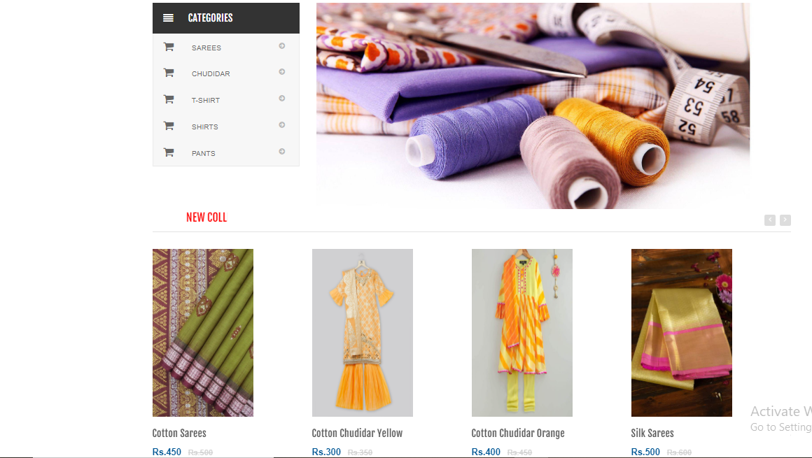
Home Page

Slide 9
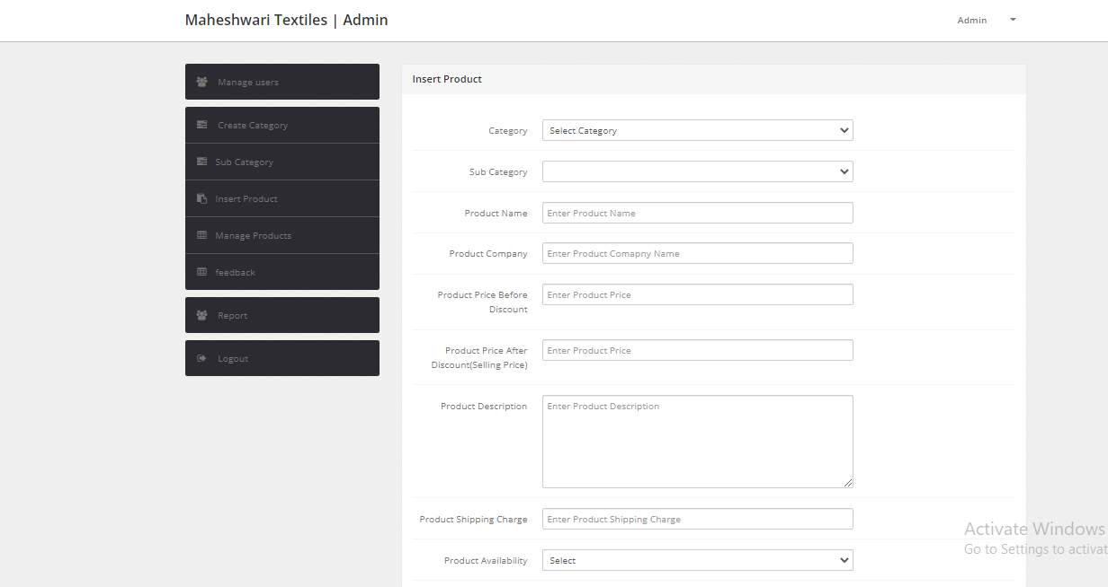
Add Product Page

Slide 10
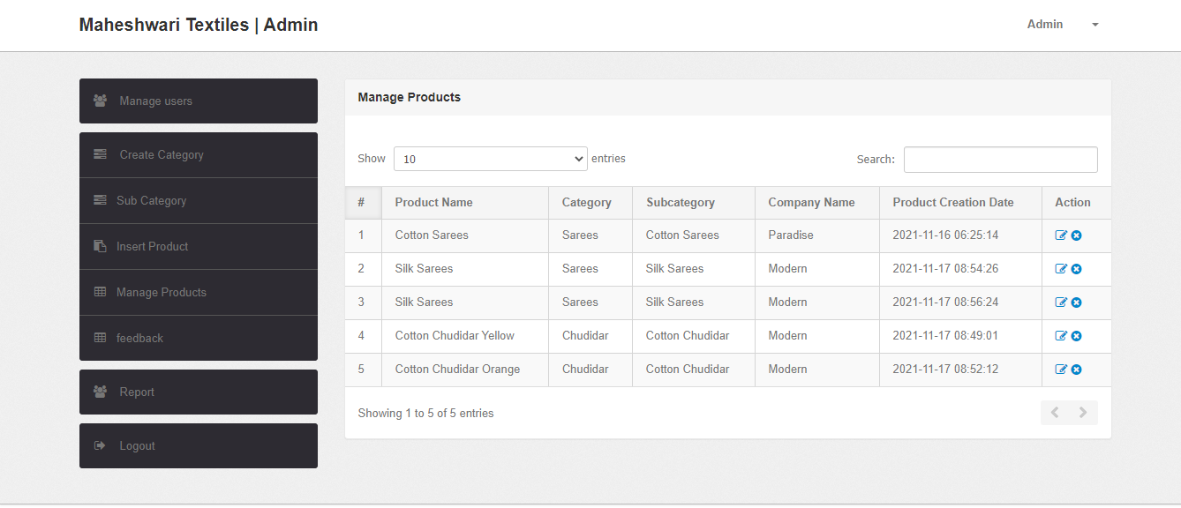
Manage Products Page

Slide 11
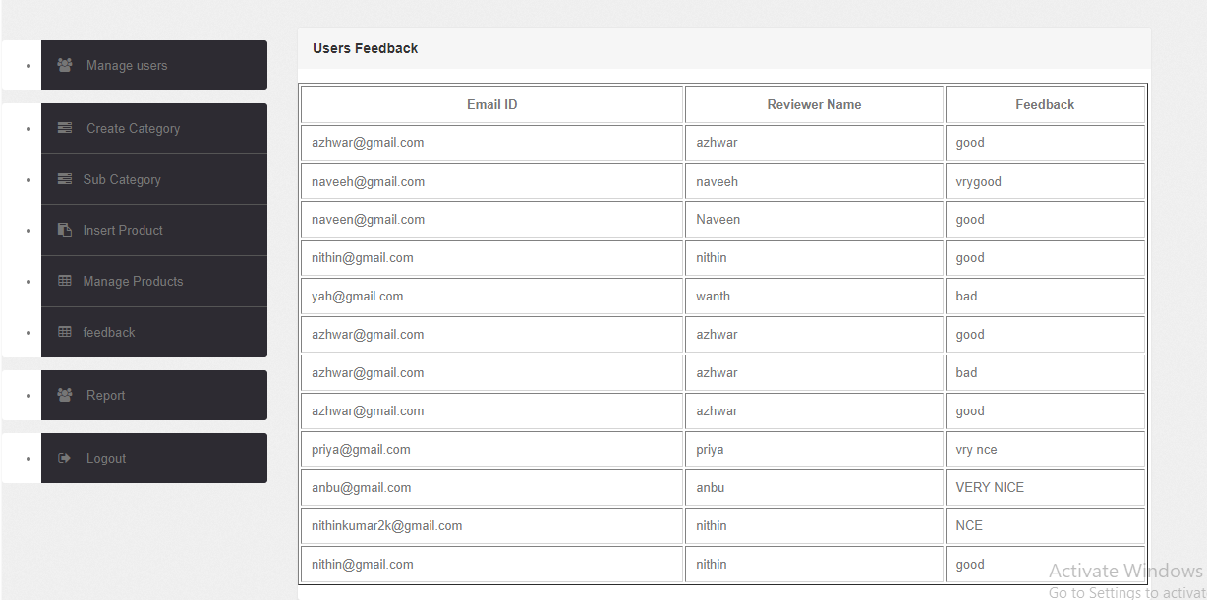
Feedback Page

Slide 12
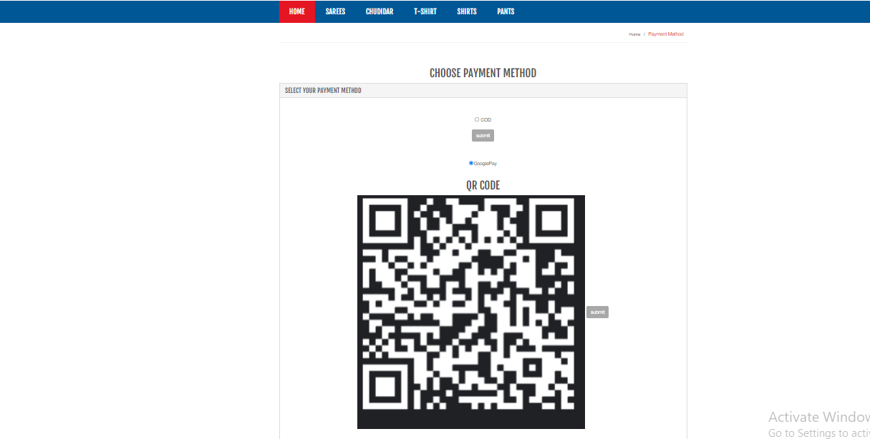
Payment Method Page

Slide 13
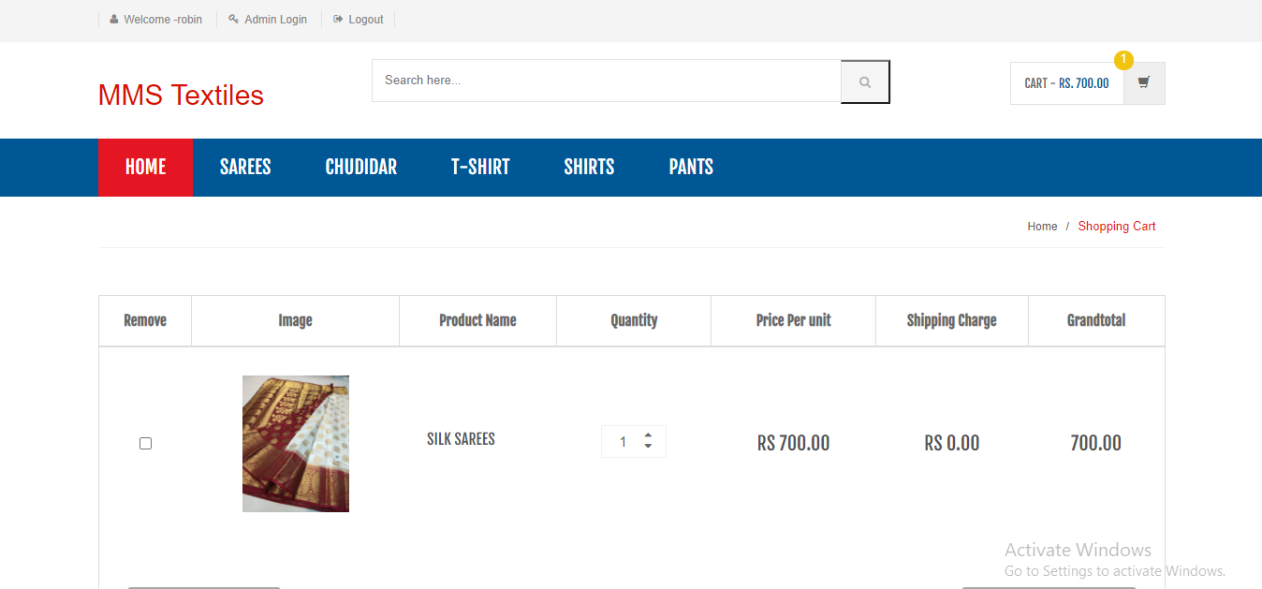
My Cart Page

Slide 14
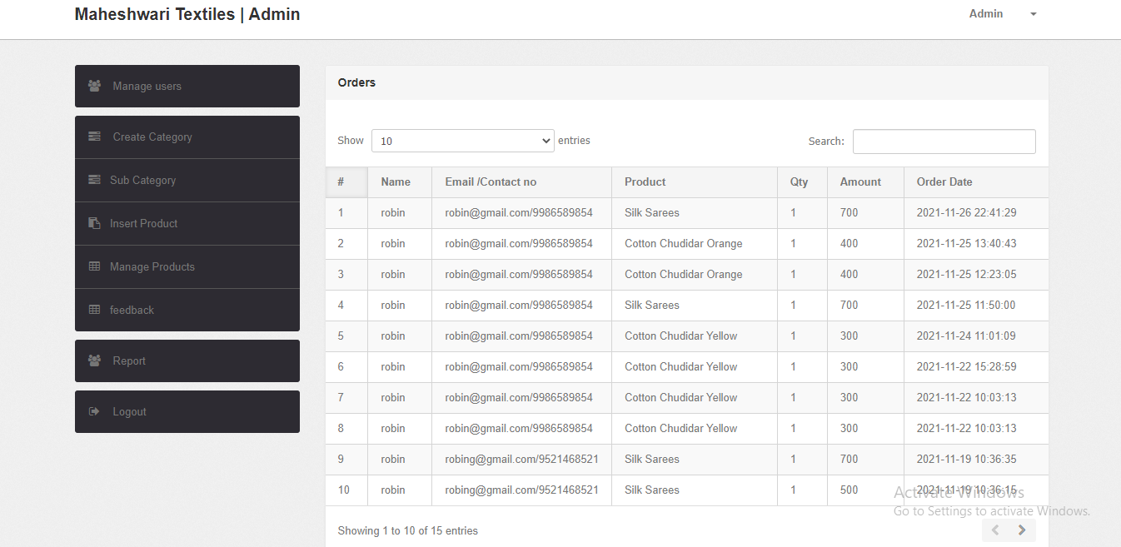
Report Page

Slide 15
Thank You

